Slide 1
A Multi-Armed-Bandit Strategy for E-Commerce of Cruise Booking
Online Learning Applications – Project Report – Academic Year 2021-2022
Alberto Francese, Carlo Ghiglione, Jacopo Ghirri e Marta Mastropietro

Slide 2
INDEX
Problem setting
Optimal Solutions
The Environment
Price Puller
Greedy Approach
Learning in Simple Environment
Learning With Uncertain Parameters
Learning Transition Probabilities
Change Detection
Context Generation

Slide 3
1. Problem Setting

Slide 4
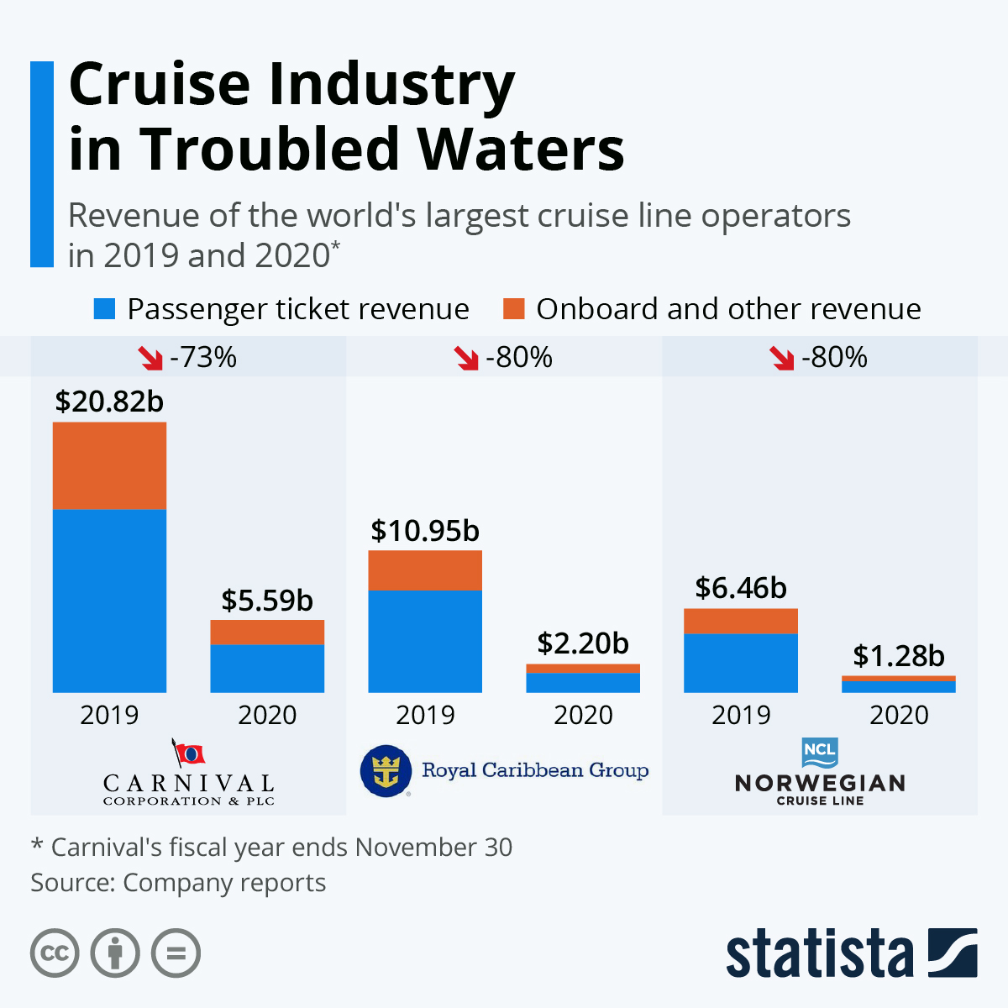
1. The Market
In 2019 the cruise industry was booming with 29.7 million of passangers.
The covid pandemic has devasted cruise companies as many ship becames contagion hotspot being defined by the press as ‘floating petri dishes’.
In 2020 cruise companies as Canival Corporation, Royal Caribbean and Norwegian Cruise Line lost over 80% of their revenues.
To «stay afloat» many companies decided to offer bonus credits (up to 125% of the booking amount) rather than cash flow to avoid loosing more cash founds.
What we suggest is a new way of booking cruise to increase onboard revenues, anticipate many revenues and reduce costs via before-hand planning.
Notes:
Effects of COVID-19 on Global Cruise Industry - Company Debt

Slide 5
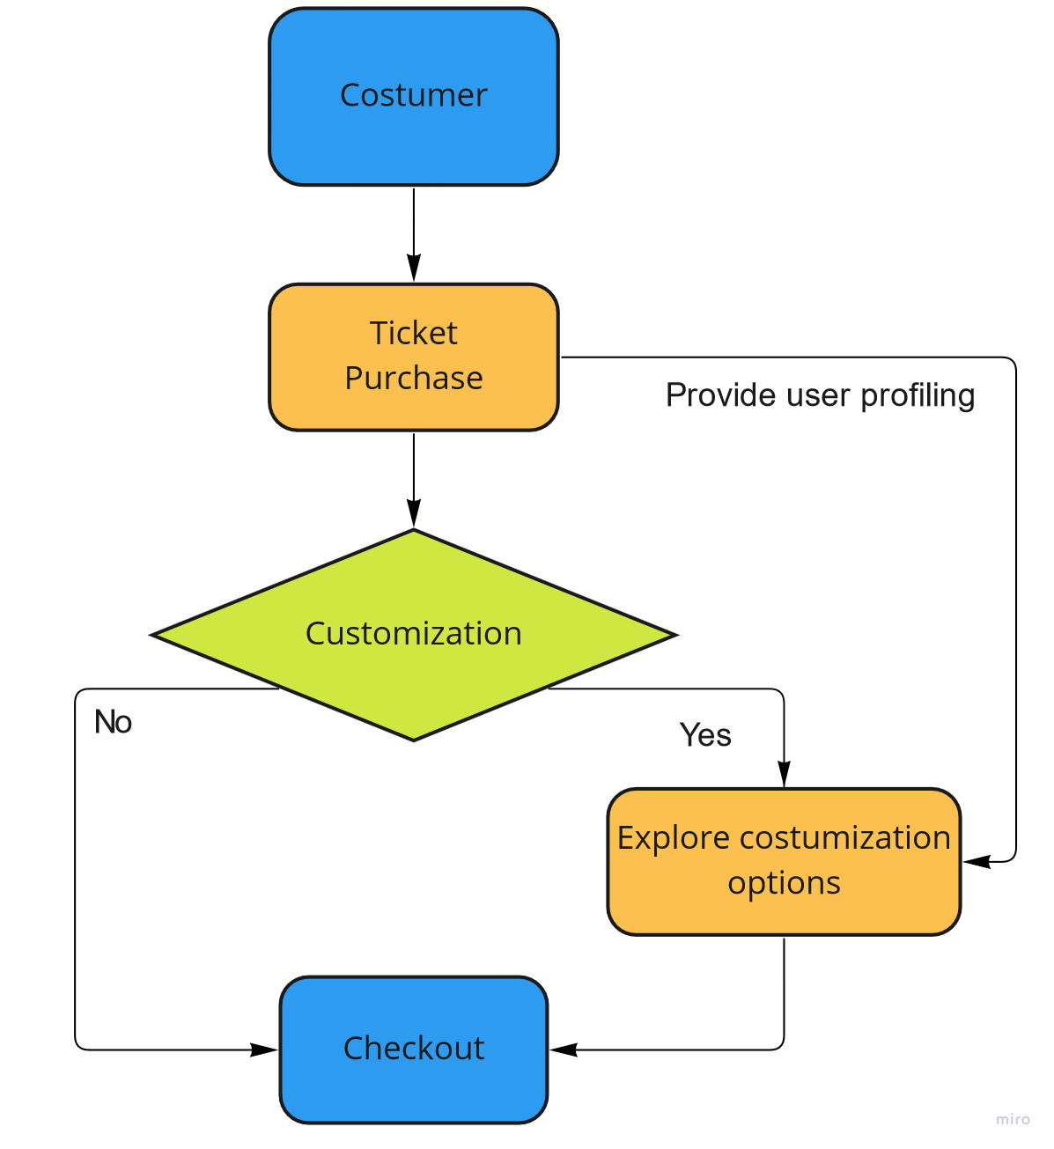
1. The Costumer Journey
In our proposal, after customers purchase a ticket, they are given the opportunity to buy in advance further «experiences» for their trip.
After the purchase of the ticket, customers are asked if they want to pre-order experiences, like it happens in flight companies. If costumers choose to personalize the trip, they enter a website where experiences can be booked, starting from their first choice.
If customers decide to purchase the proposed experience, the site suggests two additional experiences to check out and possibly buy and the exploration continues.

Slide 6




1. Costumer Context Setting
Based on the information that we retrive from the purchase of the ticket we can divide customers in different segments. The factors that we have chosen to classify users with are:
The amount of ticket bought, hence inferring if the costumer is single or travelling as a couple.
The use or not of a discount for retired people.
Based on this information we create 3 contexts:
͏Singles
͏Young couples
͏Senior couples
We do not distinguish singles with respect to their age as we assume that the purchasing behavior of singles in a cruise ship is independent w.r.t. seniority.
12.5% | 12.5%
45% | 30%
Proportion of user partition

Slide 7


1. Products: The Captain Experience
Description: What is more exciting than being in the cockpit of a boat of over 180.000 tons? With this experience, you can live the captain life for a full hour, understanding all procedures, exploring the millions of colorful buttons and, who knows, maybe even stirring the rudder wheel. Taking photos is highly encouraged!
Characteristics: This experience has the most significant margins, but due to its exclusivity, few people are willing to buy it, and even fewer will do it more than once. Among all, the segment more interested is senior couples.
Margins:
Mean number of purchases (during the whole trip):
Singles | Senior couples | Young couples
1.1 | 1.2 | 1.1

Slide 8
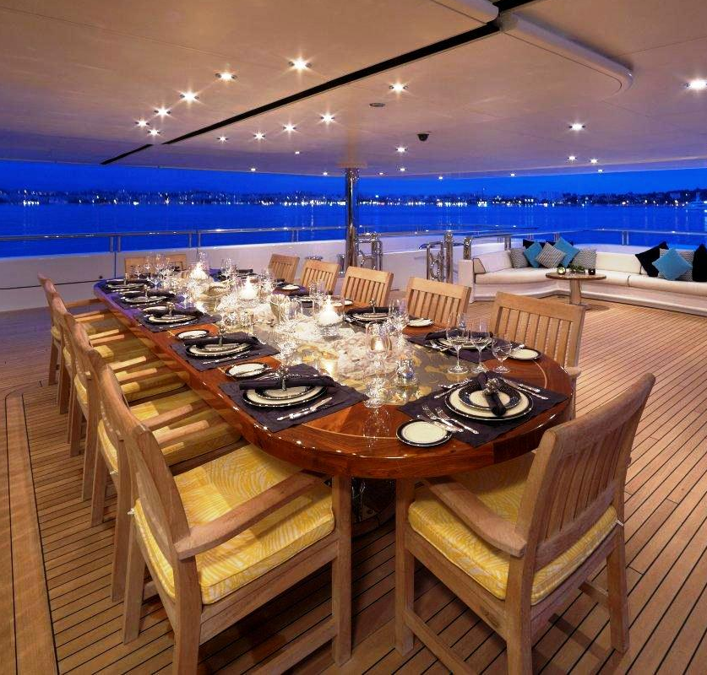

1. Products: Dinner on Deck
Description: Dreaming a super romantic dinner on the cruise? We can offer even that! Book an exclusive dinner on the deck of our cruise, you will enjoy, beneath the starry sky, one of the most sophisticated menu prepared by our chef just for you. perfect for couple but also for our gluttonous customers.
Characteristics: This experience has high margins, it is particularly popular among couples who often book more than one night during their stay.
Margins:
Mean number of purchases:
Singles | Senior couples | Young couples
2.0 | 4.0 | 3.0

Slide 9


1. Products: Tropical Cocktail Tasting
Description: Sun, fresh breeze from the sea, your feet in the pool and a cold tropical cocktail in your hand; what you could ask more? According to us, nothing. Try some samples from our list of over a hundred cocktails and enjoy the "sweet doing nothing" on the poolside.
Characteristics: This experience has the lowest margin but is loved by both singles and young couple who often buy this experience more than once, on the contrary senior couples are not really into it.
Margins:
Mean number of purchases:
Singles | Senior couples | Young couples
4.0 | 1.5 | 4.0

Slide 10


1. Products: The Adventurers’ Package
Description: Relaxing is too boring? We have the experience for you! Clay-target shooting, jet-ski, surfing, swimming with the shark. All the extreme sports that you want to try we provide, just try to not get too addicted to it!
Characteristics: This experience has a medium margin, is particularly disliked by senior couples and has a medium popularity among singles and young couples.
Margins:
Mean number of purchases:
Singles | Senior couples | Young couples
2.5 | 1.5 | 2.0

Slide 11


1. Products: SPA on The High Seas
Description: Could you say you have been on a cruise if you have never been to the SPA? Let our professional massage therapists take care of you. Our experts can satisfy all your needs, from accumulated tension to back hurting, you will feel ten years rejuvenated after this experience.
Characteristics: This experience has a medium margin, is especially liked by young couples and singles.
Margins:
Mean number of purchases:
Singles | Senior couples | Young couples
3.0 | 2.0 | 2.0

Slide 12
1. Conversion Rates
The cruise market is affected by seasonality, which itself influences conversion rates.
In general, the season can be split into two:
High Season: period close to summer and winter holidays when people are more likely to buy more experiences.
Low Season: period just after summer and winter holiday where customer are usually cautious about spending money on additional packages.
In general, we have estimated higher conversion rates compared to a normal e-commerce because users have already bought the ticket to the cruise and the experience that is being booked would be probably bought anyway once they are on the cruise itself.

Slide 13
1. Conversion Rates: High Season
1
2
3
4
5
The Captain Experience
Dinner on Deck
Tropical Cocktail Tasting
The Adventures’ Package
SPA on the High Seas
Single | Super-Offer | Discount | Full-Price | Extra-price
1 | 0.05 | 0.01 | 0.00 | 0.00
2 | 0.20 | 0.10 | 0.05 | 0.00
3 | 0.60 | 0.55 | 0.50 | 0.45
4 | 0.30 | 0.25 | 0.20 | 0.10
5 | 0.27 | 0.20 | 0.25 | 0.20
Young Couple | Super-Offer | Discount | Full-Price | Extra-price
1 | 0.15 | 0.07 | 0.05 | 0.00
2 | 0.38 | 0.35 | 0.30 | 0.10
3 | 0.30 | 0.30 | 0.27 | 0.20
4 | 0.23 | 0.20 | 0.17 | 0.10
5 | 0.17 | 0.30 | 0.25 | 0.20
Senior Couple | Super-Offer | Discount | Full-Price | Extra-price
1 | 0.23 | 0.30 | 0.27 | 0.25
2 | 0.30 | 0.37 | 0.35 | 0.30
3 | 0.03 | 0.07 | 0.01 | 0.00
4 | 0.00 | 0.05 | 0.03 | 0.00
5 | 0.15 | 0.05 | 0.03 | 0.00

Slide 14
1. Conversion Rates: Low Season
1
2
3
4
5
The Captain Experience
Dinner on Deck
Tropical Cocktail Tasting
The Adventures’ Package
SPA on the High Seas
Single | Super-Offer | Discount | Full-Price | Extra-price
1 | 0.20 | 0.15 | 0.10 | 0.05
2 | 0.10 | 0.05 | 0.00 | 0.00
3 | 0.30 | 0.22 | 0.20 | 0.10
4 | 0.29 | 0.23 | 0.20 | 0.15
5 | 0.27 | 0.20 | 0.25 | 0.20
Young Couple | Super-Offer | Discount | Full-Price | Extra-price
1 | 0.15 | 0.15 | 0.10 | 0.05
2 | 0.20 | 0.17 | 0.08 | 0.05
3 | 0.23 | 0.17 | 0.14 | 0.10
4 | 0.15 | 0.10 | 0.05 | 0.00
5 | 0.17 | 0.30 | 0.25 | 0.20
Senior Couple | Super-Offer | Discount | Full-Price | Extra-price
1 | 0.30 | 0.30 | 0.20 | 0.10
2 | 0.30 | 0.27 | 0.17 | 0.10
3 | 0.15 | 0.07 | 0.01 | 0.00
4 | 0.10 | 0.02 | 0.01 | 0.00
5 | 0.15 | 0.05 | 0.03 | 0.00

Slide 15
2. Optimal Solutions

Slide 16
2. Determining Prices
Each product comes with 4 possible prices: a regular price, an overprice, a discount and a super offer.
Our goal is to determine the best price configuration, possibly depending on different costumer contexts and seasons, while having various degrees of information at our disposal.
We now present the optimal pricing strategies for all the scenarios we encounter in the developement of this project; all our learners eventually succeed in learning such policies, with the exceptions and issues that will be discussed as they occur.

Slide 17
2. Aggregated Problem Pricing Profile
The base environment for our learners will be the High Season scenario, without the possibility of discerning contexts.
In such an environment the optimal strategy found by an exact clairvoyant algorithm is:
The Captain Experience: Overprice
Dinner on Deck: Regular price
Tropical Cocktail Tasting: Discount
The Adventurers’ Package: Discount
SPA on the High Seas: Regular Price
Using such a strategy leads to an expected extra profit of 69,08€ per costumer.

Slide 18
2. Low Season Pricing Profile
During Low Season prices need to adapt to costumers’ behaviour, in this environment we are still adopting an aggregated approach.
In such an environment the optimal strategy found by an exact clairvoyant algorithm is:
The Captain Experience: Discount
Dinner on Deck: Super Offer
Tropical Cocktail Tasting: Discount
The Adventurers’ Package: Super Offer
SPA on the High Seas: Regular Price
Using such a strategy leads to an expected extra profit of 42,12€ per costumer.

Slide 19
2. Targeted Pricing Profile: Singles
During High Season we ultimately try to devise context-specific pricing strategies.
On costumers classified as being single the optimal pricing strategy found by an exact clairvoyant algorithm is:
The Captain Experience: Super Offer
Dinner on Deck: Super Offer
Tropical Cocktail Tasting: Overprice
The Adventurers’ Package: Discount
SPA on the High Seas: Regular Price
Using such a strategy leads to an expected extra profit of 62,20€ per single costumer.

Slide 20
2. Targeted Pricing Profile: Senior Couples
During High Season we ultimately try to devise context-specific pricing strategies.
On costumers classified as being part of a senior couple the optimal pricing strategy found by an exact clairvoyant algorithm is:
The Captain Experience: Overprice
Dinner on Deck: Overprice
Tropical Cocktail Tasting: Overprice
The Adventurers’ Package: Discount
SPA on the High Seas: Regular Price
Using such a strategy leads to an expected extra profit of 94,44€ per costumer in a senior couple.

Slide 21
2. Targeted Pricing Profile: Young Couples
During High Season we ultimately try to devise context-specific pricing strategies.
On costumers classified as being part of a young couple the optimal pricing strategy found by an exact clairvoyant algorithm is:
The Captain Experience: Super Offer
Dinner on Deck: Regular Price
Tropical Cocktail Tasting: Discount
The Adventurers’ Package: Discount
SPA on the High Seas: Discount
Using such a strategy leads to an expected extra profit of 57,10€ per costumer in a young couple.

Slide 22
3. The Enviroment

Slide 23
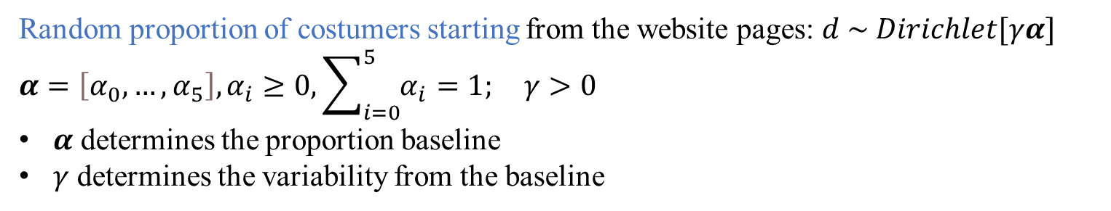
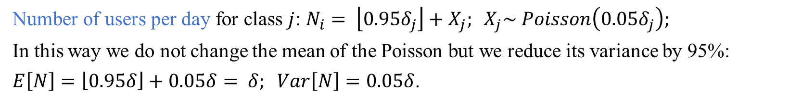
3. Modeling Choices
Number of users per day for class $j$: $N_{i}= \left\lfloor 0.95δ_{j}\right\rfloor +X_{j}; X_{j}\sim Poisson\left(0.05δ_{j}\right);$
In this way we do not change the mean of the Poisson but we reduce its variance by 95%:
$E\left[N\right]=\left\lfloor 0.95δ\right\rfloor +0.05δ= δ; Var\left[N\right]=0.05δ$.
Random proportion of costumers starting from the website pages: $d \sim Dirichlet[γα]$
$$α=\left[α_{0},…, α_{5}\right], α_{i}≥0, \sum_{i=0}^{5}{α_{i}}=1; γ>0$$
$α$ determines the proportion baseline
$γ$ determines the variability from the baseline
Random number of purchases of product $i$ for class $j$: $p_{ij}=1+ep_{ij}, ep_{ij} \sim Poisson\left(θ_{ij}\right), E\left[p_{ij}\right]=1+θ_{ij}$

Slide 24
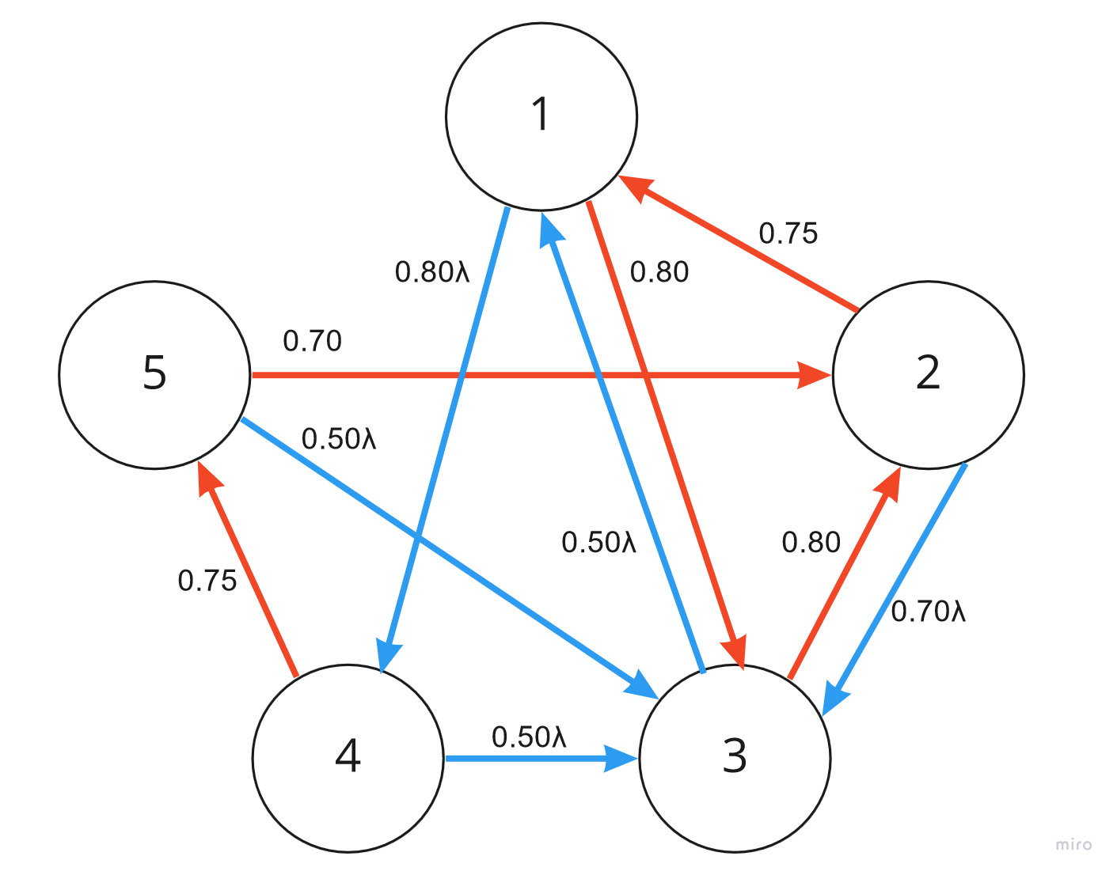

3. Transition Probabilities
The Captain Experience
Dinner on Deck
Tropical Cocktail Tasting
The Adventurers’ Package
SPA on The High Seas
First shown
Second shown
$$λ=0.85$$

Slide 25
3. Simulation Classes: Hyperparameters
Input: hyperparameters of the simulation.
Description: wrapper class holding the hyperparameters of the simulation.
Attributes:
Transition probabilities matrices for each class;
Dirichlet parameters of random proportion of landing in the website;
Poisson parameters of number of users per day;
Conversion rates matrices for each class;
Margin matrix;
Poisson parameters of random purchase per product.
Hyperparameters
trans_prob : list[matrix[float]] dir_param : list[array[float]] pois_param : array[int] conv_rate : list[matrix[float]] margin : matrix[float] pur_per_prod: matrix[float]

Slide 26
3. Simulation Classes: Daily_Website
Input: environment with the hyperparameters of the simulaton and the daily pulled prices.
Description: creates the environment accoding to the general setting and the currently proposed prices where users can navigate and purchase the products.
Attributes:
Daily parameters generated from Hyperparameter object;
Pulled prices in that day.
Methods:
Sample the user partition according to the classes;
Sample the number of users;
Select the conversion rates according to the pulled prices;
Select the margins according to the pulled prices;
Generate the users visiting the website according to the daily parameters.
Daily_Website
trans_prob: list[matrix[float]] alphas: list[array[float]] n_user: list[int] pulled_prices : array[int] n_estimated_types : int conv_rate: matrix[float] margin: array[float] env: Hyperparameters
Sample_user_partition(params) Sample_n_users(params) Select_conv_rates(conv_rates, prices) Select_margins(margins, prices) Get_user_per_prod_and_type()

Slide 27
3. Simulation Classes: User
Input: daily website, starting product and user type.
Description: simulate the exploration of the user in the website with depth first approach keeping track of its navigation and purchases.
Attributes:
Daily Website where the user can navigate;
User features;
Purchase per product;
Starting product of the navigation;
Boolean if product has been purchased;
Boolean if product has been clicked;
Counter of purchased products;
Transition probabilities of the user, updated through the navigation.
Methods:
Run a step of the simulation: decide whether to buy or not the current primary, if yes buy a certain quantity and click on the secondary product with proper probability;
Simulate the complete navigation;
Collect the revenue generated by the user.
User
website : Daily_Website features : list[boolean] pur_per_prod : matrix[float] starting_product : int products : list[boolean] clicked : list[boolean] cart : list[int] dyn_trans_prob: matrix[float]
new_primary(product_index) simulate() checkout()

Slide 28
3. Simulation Classes: Day
Input: hyperparameters of the simulation, daily pulled prices.
Description: creates the daily website from global parameters and pulled prices, generated the daily users, simulates their navigation and collects from them the information needed to update the prices the next day.
Attributes:
Daily pulled prices;
Environment with the hyperparameters and purchase per product parameters;
Daily profit and daily website;
Number of users per initial product and type;
Counter of items sold per product type;
Counter of number of users that bought type of product;
Counter of number of costumers that clicked type of product.
Methods:
Run simulation of navigation in the website for all the daily users;
Run simulation of optimal navigation in the website for all the daily users, using the best pricing strategy.
Day
pulled_prices : list[int] env : Hyperparameters pur_per_prod : matrix[float] profit : float website : Daily_Website n_user : matrix[int] items_sold : list[int] individual_sales : list[int] individual clicks : list[int]
run_simulation() run_clairvoyant_simulation()

Slide 29
3. Simulation Mechanism
Simulation algorithm:
Set the global parameters, initialize the environment with Hyperparameteter class.
Initialize the Learner object.
For day in 1:T
Create a Day object that initializes the Daily Website (with pulled prices) and the list of daily Users with their type and initial product.
Simulate the navigation of all the users.
Collect the daily navigation info from Day.
Update the Learner with the observed data.
Pull the next day prices.

Slide 30
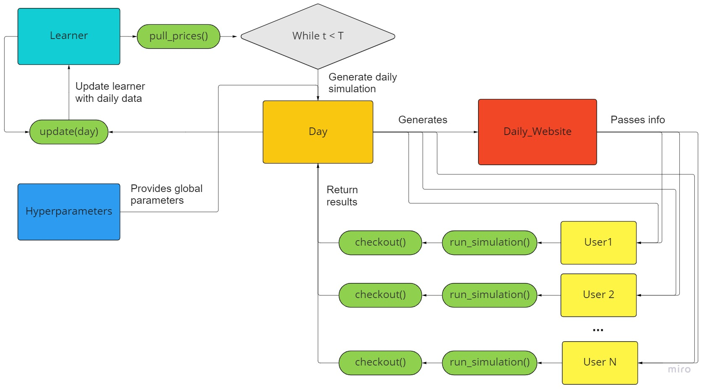
3. Simulation Mechanism

Slide 31
4. Price Puller

Slide 32
4. Two Questions
The goal is to determine the optimal price configuration (superarm).
To do so, we need to:
compute the expected profit on the problem, given the parameters (either true or estimated) and a single price configuration.
determine which price configurations to evaluate.

Slide 33
4. Sampling vs Exact Strategy
In order to compute the expected profit of the problem, the two available approaches are:
͏Monte Carlo: simulate the behaviour of a large pool of users, navigating throught the website according to the parameters given as input (either true or estimated) and the price configuration of choice. Such simulation approach requires large samples in order to deal with the intrinsic variability of the problem but it is straighforward to be applied, being the dynamic of the problem easy to simulate.
͏Exact: compute the expected profit that explicitly formulates the problem dynamics in a mathematical way and compute the true expected value given the parameters (either true or estimated) and a price configuration. The cost of such computation is independent from the problem’s variability, but it scales factorially in the problem size.

Slide 34
4. Exact Profit Calculator
We now discuss the exact strategy for computing the expected value on the problem, given a price configuration.
The core idea revolves around a full enumeration of all the possible exploration paths starting from the firstly displayed product. Such paths consist of a subset of the order permutations of all the products, discarding the chains that would imply a primary-secondary connection that does not exists.
We then exploit conditional probabilities to compute:
The probability that a product is bought in an exploration path.
The probability that a product has already been shown as primary when said chain is being explored.
The probability that a product is bought in any chain, given the starting product.
Indeed the chain structure and ordered sequence mimics the order that is caused by the depth-first approach of the exploration of the website.

Slide 35
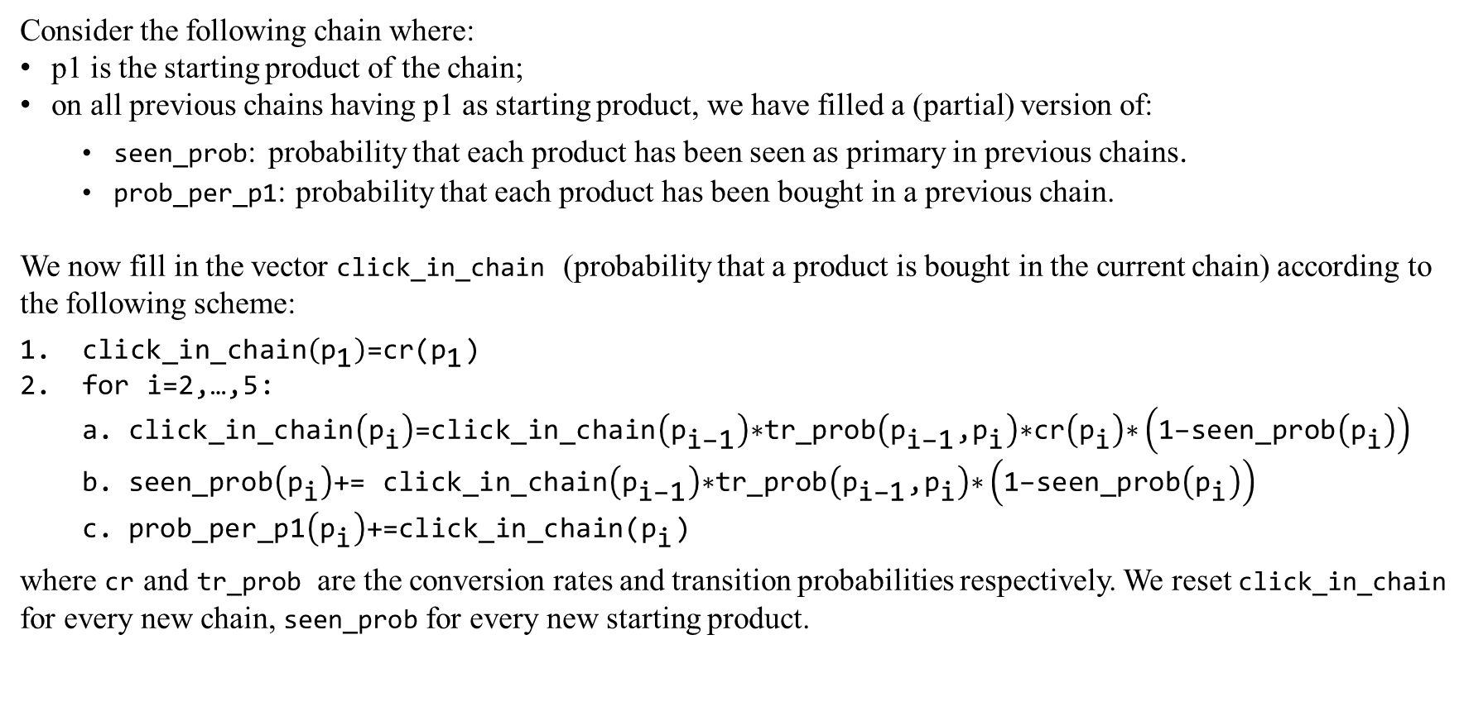
4. Exact Profit Calculator: Mathematics
Consider the following chain where:
p1 is the starting product of the chain;
on all previous chains having p1 as starting product, we have filled a (partial) version of:
seen_prob: probability that each product has been seen as primary in previous chains.
prob_per_p1: probability that each product has been bought in a previous chain.
We now fill in the vector click_in_chain (probability that a product is bought in the current chain) according to the following scheme:
$\text{click}\text{_}\text{in}\text{_}\text{chain}\left({\text{p}}_{\text{1}}\right)\text{=}\text{cr}\text{(}{\text{p}}_{\text{1}}\text{)}$
$\text{for} \text{i}\text{=2,…,5:}$
$\text{click}\text{_}\text{in}\text{_}\text{chain}\left({\text{p}}_{\text{i}}\right)\text{=}\text{click}\text{_}\text{in}\text{_}\text{chain}\left({\text{p}}_{\text{i}\text{−1}}\right)\text{∗}\text{tr}\text{_}\text{prob}\left({\text{p}}_{\text{i}\text{−1}}\text{,}{\text{p}}_{\text{i}}\right)\text{∗}\text{cr}\left({\text{p}}_{\text{i}}\right)\text{∗}\left(\text{1−}\text{seen}\text{_}\text{prob}\left({\text{p}}_{\text{i}}\right)\right)$
$\text{seen}\text{_}\text{prob}\left({\text{p}}_{\text{i}}\right)\text{+= }\text{click}\text{_}\text{in}\text{_}\text{chain}\left({\text{p}}_{\text{i}\text{−1}}\right)\text{∗}\text{tr}\text{_}\text{prob}\left({\text{p}}_{\text{i}\text{−1}}\text{,}{\text{p}}_{\text{i}}\right)\text{∗}\left(\text{1−}\text{seen}\text{_}\text{prob}\left({\text{p}}_{\text{i}}\right)\right)$
$\text{prob}\text{_}\text{per}\text{_}\text{p}\text{1}\left({\text{p}}_{\text{i}}\right)\text{+=}\text{click}\text{_}\text{in}\text{_}\text{chain}\text{(}{\text{p}}_{\text{i}}\text{)}$
where cr and tr_prob are the conversion rates and transition probabilities respectively. We reset click_in_chain for every new chain, $\text{seen}\text{_}\text{prob}$ for every new starting product.
p1 | p2 | p3 | p4 | p5

Slide 36
4. Exact Profit Calculator: Mathematics
We perform this computation for every starting product and for every user type (if contemplated), finally averaging the results of prob_per_p1 according to the (possibly estimated) Dirichlet expected value in order to consider the probability that a user actually starts the exploration from the product.
Then, we multiply the resulting total purchase probability by the expected number of units purchased by that type of user (if different types are contemplated, else using global estimates) and, finally, by the rescaled Poisson coefficients taking into account the probability that a user is actually of the type corresponding to the parameters.
This procedure yields a global computation of the expected number of units purchased by a generic user that, if multiplied by the respective margin, it provides the exact expected profit. Moreover, the multiplication by the expected total number of users provides the total expected profit.

Slide 37
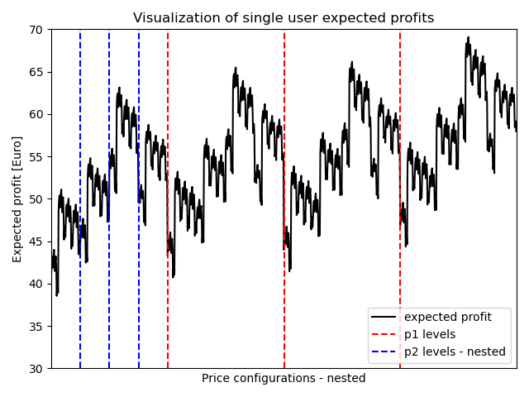
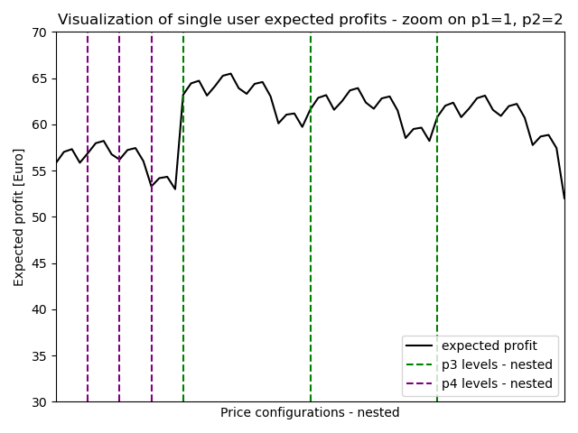
4. Exact Profit Calculator: Visualization
We report the expected profits over all price configurations for the High Season aggregated problem.

Slide 38
4. Exact Profit Calculator: MC comparison
We stress the fact that such a calculator is really computationally expensive, and should not be considered an available option in a real world scenario due to the total number of combinations scaling factorially with the number of items.
However, given the small scale of the problem at hand (only five products with a sparse connection network), the exact approach is still more efficient than a sampling based strategy like Monte Carlo.
The following experiments show how even a static clairvoyant strategy still retains a considerable variability in its results, even with a high number of users navigating the website each day.
Any MC strategy, to be deemed reasonable, would need a large enough sample size to mediate such variance and for our problem we state that it is easier, faster and far more accurate to stick with the exact approach. Indeed, the exact profit calculator evaluates all the 1024 price configurations in few seconds whereas the MC based strategy provides reasonable estimates still affected by high noise in more than half a minute.

Slide 39
4. Need for Exploration Strategy
To find the optimal pricing profile we still need a strategy for comparing different profiles.
A brute force approach would be a full listing of all possible pricing profiles, computing the expected price of all of them with the selected approach (either Monte Carlo or exact computation).
Such an approach scales exponentially with the problem size (number of products and number of possible prices), for this reason we investigate a greedy approach to limit this exploration to a limited set of pricing profiles, while still guaranteeing convergence to a (locally) optimal profile.

Slide 40
5. Greedy Approach

Slide 41
5. Introduction
Greedy approach to find the best price configuration:
Start with the price configuration where each product has the lowest available price and compute its expected profit. This strategy is the base strategy.
Evaluate the one-level increment for each product (up to the maximum available price), consider the one with the largest expected profit.
If its expected profit is larger than the one of the base strategy, consider the incremented strategy as the new base and iterate 2.
Else stop the search and return the base strategy.

Slide 42
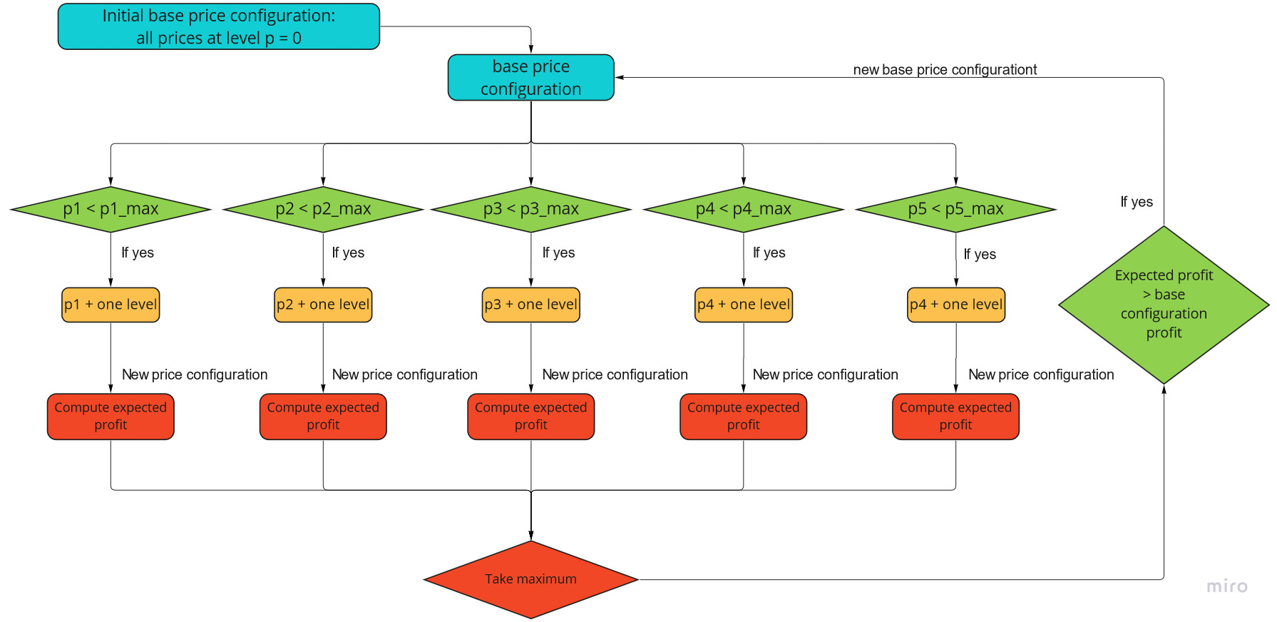
5. Algorithm Structure
Fare clic per inserire testo

Slide 43
5. Full Evaluation vs Greedy Approach
The necessary step to determine how to find the optimal pricing policy is to decide whether to evaluate all price configurations or to just evaluate a small portion of them via the greedy approach.
The greedy approach is likely to get stuck in local optima, both in the single step but also on the actual optimal solution that it strives to.
In the actual data such an issue accurs only in the form of a less efficient exploitation of the available information resulting in a higher regret, but still with satifying performances. We should report, however, that it is usually the case that local optima prevent the learner from finding the optimal solution.

Slide 44
5. Full Evaluation vs Greedy Approach
Moreover, while working on previous experiments containing close local optima, we notice sometimes the stochasticity of the results allows the algorithm to jump from one local optimum to the other. This determines either linear or even decreasing pseudo regret plots, depending if the solution where the algorithm converges is slightly better or worse than the one found by the greedy approach using the true parameters.
Such issues could have, at first glance, compromised our results, whereas they just are symptoms of the greedy algorithm.
For this reason and for the fact that for such a small problem the computational improvement is not worth pursuing, we ultimately decide to stick with a full evaluation of all pricing profiles. Nevertheless, we report a comparison of the two approaches applied on Thompson Sampler based learners in Section 3.

Slide 45
6. Learning In Simple Environment

Slide 46
6. General Structure
We tackle the simplified problem where the only unknown variables are the conversion rates.
We build a learner structured as follows:
One independent learner for each product.
A single interface for updates and action determination.
A joint price determination strategy.
Strategies differ in:
type of independent learner used (UCB vs TS)
price determination strategy (Greedy vs Complete, Monte Carlo vs Exact).

Slide 47
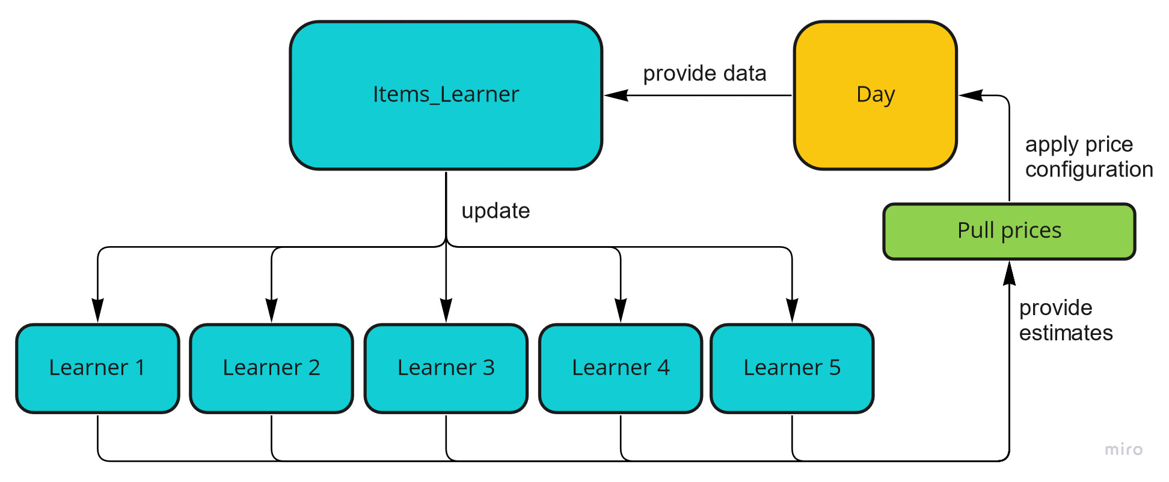
6. Algorithm Structure
We learn the conversion rates of each product independently.
We need to:
make decisions based on all the five learners simultaneously;
have an easy way to provide the right data to each learner.
We introduce the class Items_Learner to easily perform such joint operations.

Slide 48
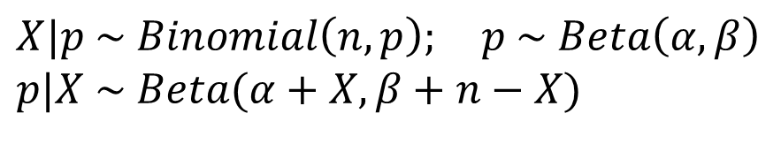
6. Thompson Sampling
For Thompson Sampling we exploit a Beta-Binomial model, where we update the belief over each arm in a batch-like manner (all clicks collected in the day for the product).
$$X|p \sim Binomial\left(n, p\right); p \sim Beta\left(α,β\right)$$
$$p|X \sim Beta(α+X, β+n−X)$$
As stated in Section 2, the price determination strategy operates on two levels:
Which price configurations to evaluate:
greedy approach;
brute force approach.
How to evaluate a price configuration:
Monte Carlo based method;
Exact profit calculator.

Slide 49
6. Class Summary
Items_UCB_Learner
env : Hyperparameters learners : list[UCB_Learner] n_arms : int n_items : int
pull_prices(env) update(day)
It should be noted that in filling the conversion rate matrix estimates for UCB, when the upper confidence bound is above 1, we threshold it at one.
Indeed it is the most optimist realistic estimate for a conversion rate and this procedure allows to easily plug in a MC-based estimator for the expected profits which needs feasible values for Bernoulli parameters.
Items_TS_Learner
env : Hyperparameters learners : list[TS_Learner] n_arms : int n_items : int
pull_prices(env) update(day)

Slide 50
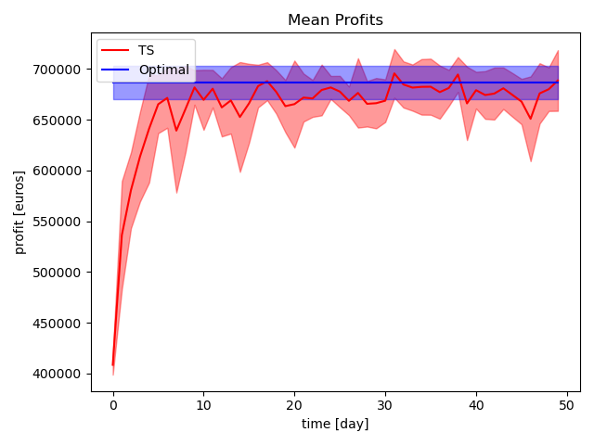
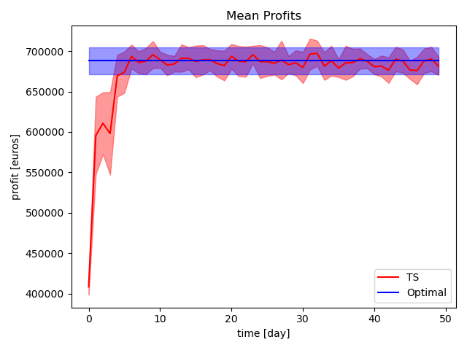
6. Greedy vs Exact Puller on TS
We evaluate the differences in performances of a greedy price decision strategy versus an exact one, where the learner of choice is Thompson Sampling.
Profit trend using greedy exact price decision.
Profit trend using brute force exact price decision.

Slide 51
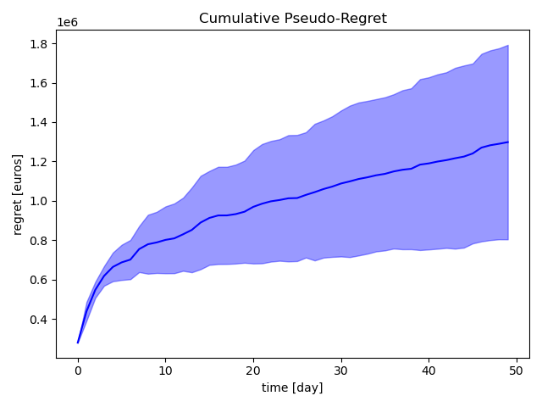
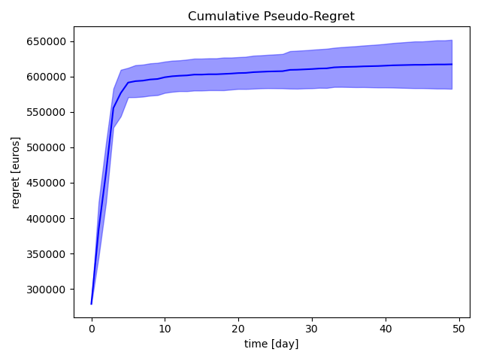
6. Greedy vs Exact Puller on TS
By using a brute force approach we are able to significantly reduce both the mean and the variance of the pseudoregret of Thompson Sampling. However, this is feasible only on small scale problems.
Pseudoregret trend using greedy exact price decision.
Pseudoregret trend using brute force exact price decision.

Slide 52
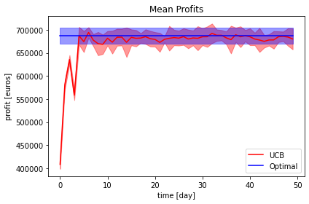
6. Results: UCB vs TS
We compare the performances of a UCB-based learner and a TS_based approach.
UCB based learner profit trend.
TS based learner profit trend.

Slide 53
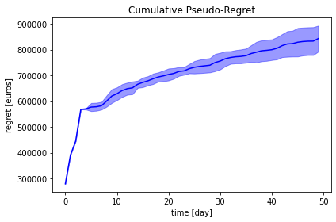
6. Results: UCB vs TS
Performances are comparable, but Thompson Sampler outperforms UCB, as expected per theoretical results.
UCB based learner profit trend.
TS based learner profit trend.

Slide 54
6. Conclusions
In all cases the pseudo-regret is logarithmic in time, as expected per theoretical bound.
The best performing algorithm is Thompson Sampler with an exact price strategy. Such approach is feasible thanks to the limited size of the problem. On more complex ones one would need a Greedy Search and possibly a Monte Carlo estimation of the expected profits.

Slide 55
7. Learning With Uncertain Parameters

Slide 56
7. Introduction
We pass to the more realistic scenario where the following parameters are not known a priori:
Alpha ratio of Dirichlet distribution;
Mean number of purchase per product.
In order to estimate them, we adopt a purely frequentist approach:
Directly update them with sample estimates;
No prior knowledge or mult-arm bandit.

Slide 57
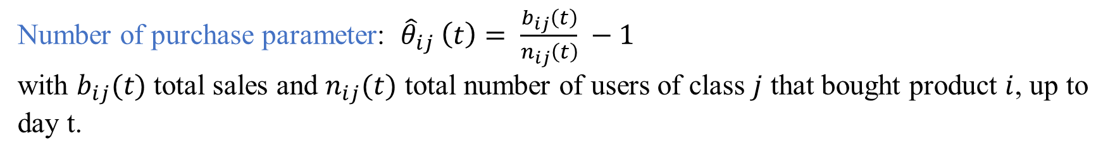
7. Frequentist Parameter Estimates
Frequentist parameter estimates:
Dirichlet parameters: ${\hat{α}}_{i}\left(t\right)= {\hat{α}}_{i}\left(t−1\right)+ n_{i}(t)$ , ${\hat{α}}_{i}\left(0\right)$ = $n_{i}(0)$
with $n_{i}(t)$ number of users that bought product $i$ at day $t$.
Number of purchase parameter: ${{\hat{θ}}_{ij}}_{ }\left(t\right)= \frac{b_{ij}\left(t\right)}{n_{ij}\left(t\right)} −1$
with $b_{ij}(t)$ total sales and $n_{ij}(t)$ total number of users of class $j$ that bought product $i$, up to day t.

Slide 58
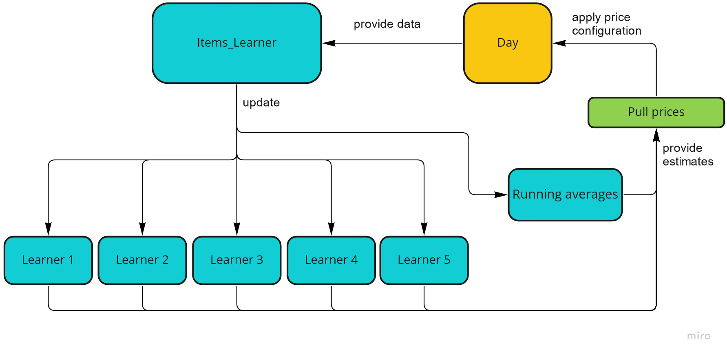
7. Algorithm Structure
Current estimates of the parameters are updated and saved in Items_Learner wrapper class that collects needed information from the daily simulation.

Slide 59
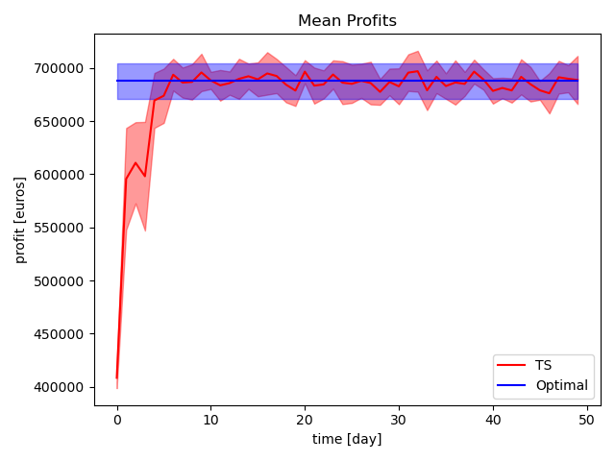
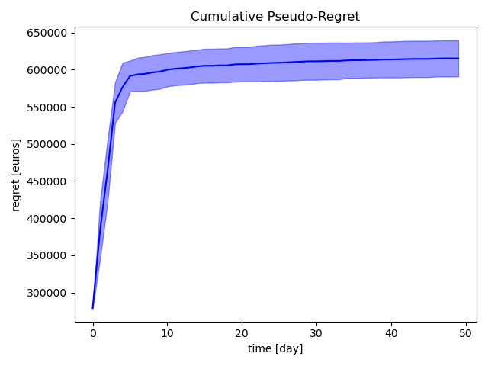
7. Conclusions
Since the additional uncertain parameters can be learned efficiently by still using a fully exploitative strategy, the regret is not significantly different from the one of the simplified case.
TS based learner profit trend.
TS based learner regret trend.

Slide 60
8. Learning Transition Probabilities

Slide 61
8. Introduction
We now aim at finding the best strategy in the case of unknown transition probabilities.
This is a simplified case of the social influence problems. Indeed, since the probability of clicking on a secondary product is independent from the conversion rate (hence the price) of the primary, we can condition on a user having actually bought the primary.
As a consequence, the data we recieve are not biased by the choices made and the actions taken on the environment. So, we sequentially learn the graph weights of the network with a purely exploitative strategy, using direct estimates of the transition probabilities. There is no exploration-exploitation tradeoff.

Slide 62
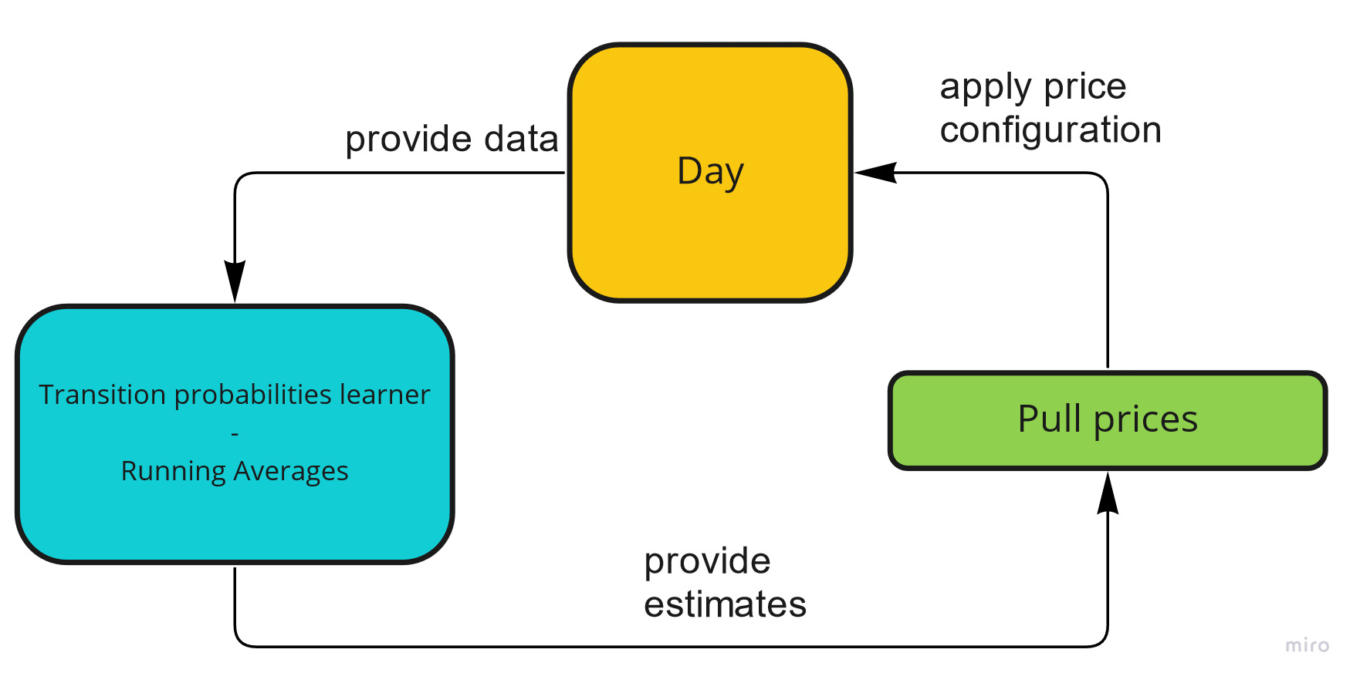
8. Algorithm Structure
The problem just boils down to extracting the number of times that a product has been shown as secondary (without having been seen before) after a given primary and the number of times that it has been clicked on for each day. We exploit the knowledge of user’s behaviour on the website to directly compute running averages for the transition probabilities with a frequentist approach from the observations.

Slide 63
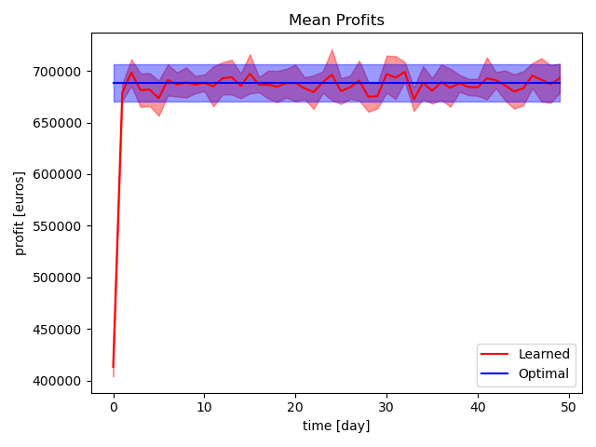
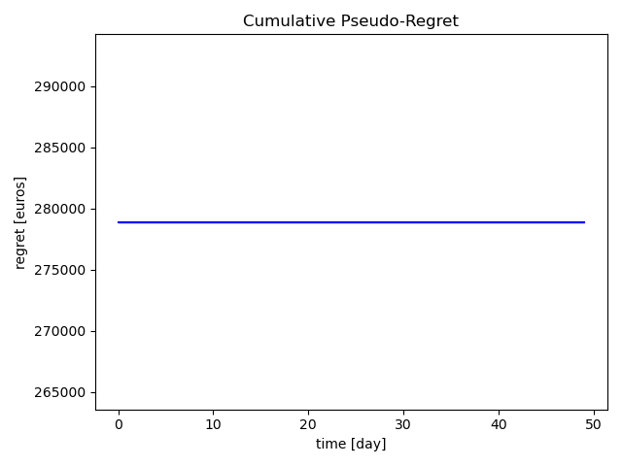
8. Conclusions
The algorithm learns particularly efficiently the optimal strategy, having minimal exploration to do. It indeed converges to the optimal price configuration after the first batch of data. It should be stressed that such batch of data is in the thousands of samples.
Profit trends.
Pseudo-Regret trends.

Slide 64
9. Change Detection

Slide 65
9. Introduction
We now introduce the different seasonalities described in Section 1.
During Low Season the pricing strategy should differ significantly as the customers expect to pay less than in High Season.
We set ourself in the scenario where, after an initial high season, we have an abrupt change into a low season, after which we move back to a high season. Each of these periods last for 30 time steps.
Such changes are abrupt, so we model them with immediate changes in the conversion rates of all the products for each pricing level.
Such a modeling choice is not unreasilistic, as seasonalities in this industry are mainly dictated by holidays and school closing, for which it is not unreasonable to assume that even a single day difference can lead to massively different behaviours on the costumers’ end.

Slide 66
9. Change Detection Strategy
In order to allow our learner to detect changes, we plug in a CUSUM mechanism on top of each independent UCB learner.
Our choice of UCB based learners is led by the immediate and easy compatibility with the CUSUM change detection mechanism.
Usually such mechanism has a treshold which, if surpassed, determines a reset of the arm over which the change has been detected. Since we can suppose a priori that such changes are abrupt, we propose an even more aggressive strategy for detecting changes so that, when a change is detected, we reset the whole learner and not just a single arm.
We then compare the performances to a Sliding Window approach, using a window 14 time steps long.

Slide 67
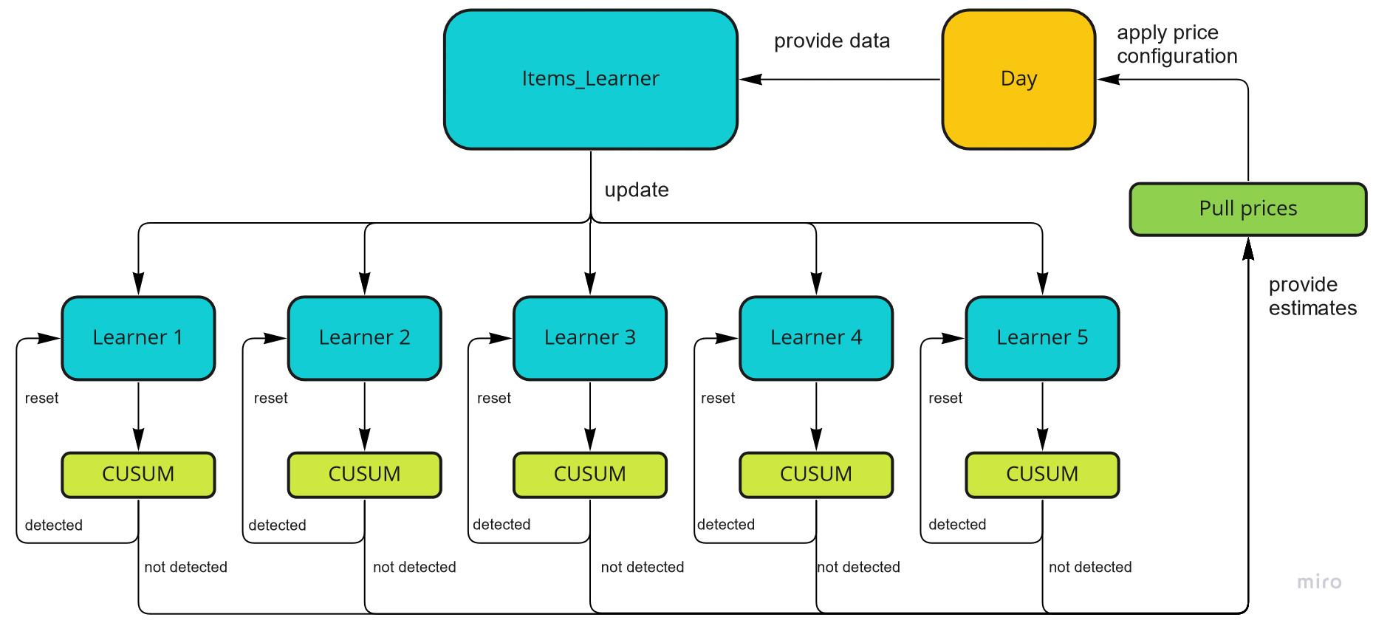
9. Algorithm Structure

Slide 68
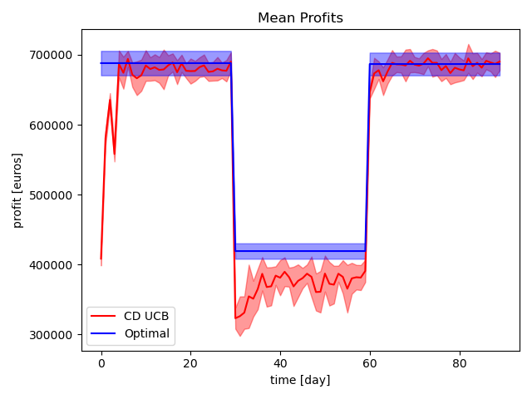
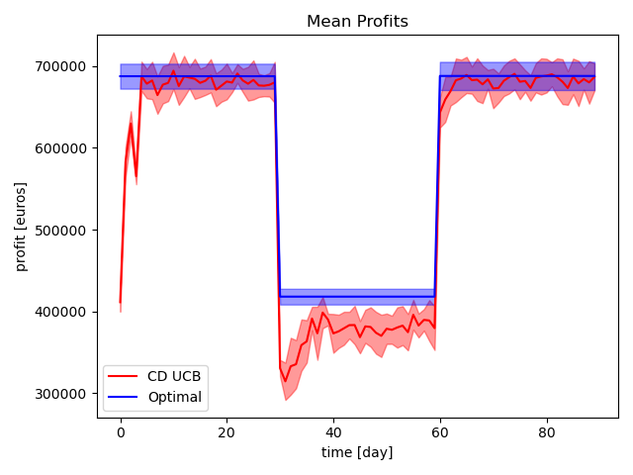
9. Results: Full Reset CUSUM
Although the full reset of the learners performed better in working trials, once applied to the proposed data there seems to be no significant differences. It should indeed be noted that in this examples seasonalities are clearly separated, and as such even a less aggressive change detection mechanism could be enough.
Standard UCB+CUSUM Profit trends.
Full Reset UCB+CUSUM Profit trends.

Slide 69
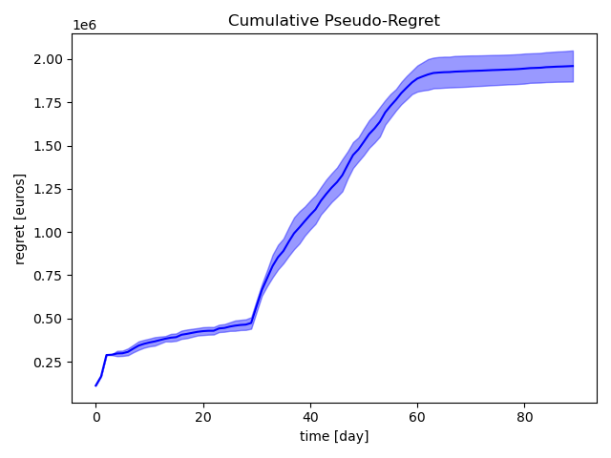
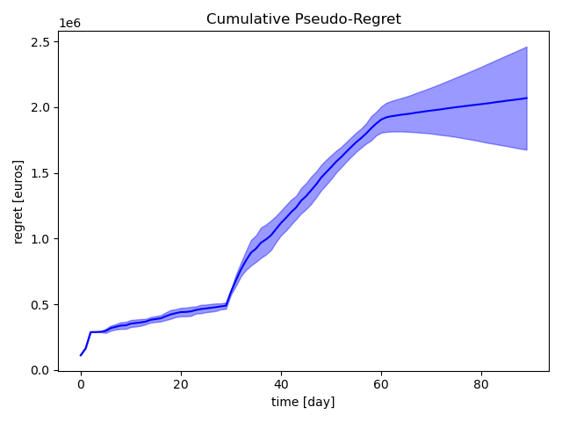
9. Results: Full Reset CUSUM
Although the full reset of the learners performed better in working trials, once applied to the proposed data there seems to be no significant differences. It should indeed be noted that in this examples seasonalities are clearly separated, and as such even a less aggressive change detection mechanism could be enough.
Standard UCB+CUSUM Regret trend.
Full Reset UCB+CUSUM Regret trend.

Slide 70
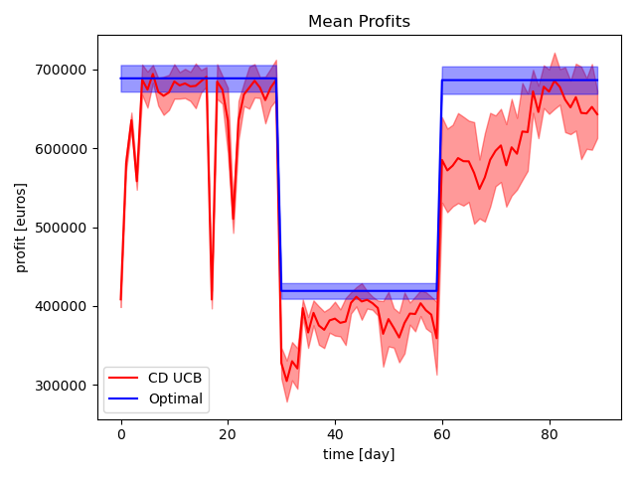
9. Results: SW Comparison
When dealing with abrupt changes a Change Detection mechanism is clearly better than sliding window. Indeed with a sliding window approach we are forcing the learner to play suboptimal superarms at least once per period, and such requirement is really detrimental to the regret.
Standard UCB+CUSUM Profit trends.
Sliding Window UCB Profit trends.

Slide 71
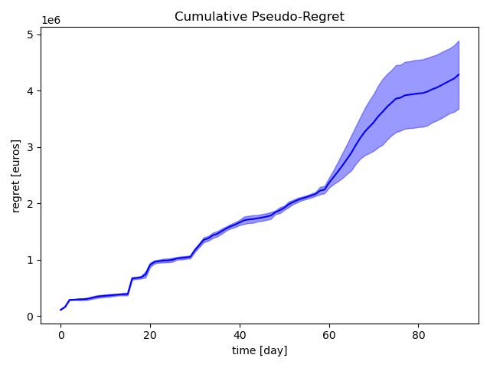
9. Results: SW Comparison
When dealing with abrupt changes a Change Detection mechanism is clearly better than sliding window. Indeed with a sliding window approach we are forcing the learner to play suboptimal superarms at least once per period, and such requirement is really detrimental to the regret.
Standard UCB+CUSUM Profit trends.
Sliding Window UCB Profit trends.

Slide 72
9. Conclusions
It should be noted that both sliding window and CUSUM require hyperparameter tuning (window width, treshold for the change), that we do not perform in our analysis.
We indeed believe that in a real world scenario, where the regret minimization is the final objective, it would be unfeasible to perform a grid search on which to tune such hyperparameters, and there is no straightforward method (to the best of our knowledge) to tune them in an online fashion in a way that is both effective and generalizable.
We arbitrarily set them as values we think are appropriate for the problem at hand, and we aknowledge the fact that our lack of experience in what could be actually sensible choiches may have significantly skewed our findings.
Nevertheless we draw our conclusions, as these issues are intrinsic to the methods we use, and so we believe that their impact should be included and does not bias our findings.

Slide 73
10. Context Generation

Slide 74
10. Introduction
Up to this point we have tried to find the best pricing strategy across all users, without exploiting the informations on the costumers.
We now exploit such information to build ad-hoc pricing strategies for the different types of users that we propose our services to. We do so by periodically (every two weeks) considering all data collected so far and running a greedy procedure for evaluating possible context splits of the two available features.
Such greedy procedure works as follows:
Evaluate if it is worth splitting w.r.t. feature A:
If not => evaluate if it is worth splitting w.r.t. feature B;
If yes => evaluate if it is worth splitting w.r.t. feature B in each sub-context independently.
We perform this evaluation by exploiting the exact method to compute the expected profits, computed on top of the lower bounded estimates obtained with the corresponding pools of data.
Feature A is set to be the one discerning between singles and couples, feature B is the one discerning seniors.

Slide 75
10. Preliminary Considerations
Our first simulations using the greedy approach for context generation fail to find the occurence of the split.
In particular, the method is able to split contexts only in the first evaluation (after 14 days), failing to do it in the following ones.
We suppose that this behaviour is due to:
high variability of the data;
trying to simulate a real case scenario, we do not have a single pricing profile that is superbly better than the others (i.e. superarm rewards are not clearly separated).
Indeed, from the second evaluation of the split, uncertainty bound widths are more influential to determine the split than the actual separation of the means. Hence, running the algorithm for long times, it is rarely the case that a split is found as not to split yields much lower confidence bounds. The method is too conservative.

Slide 76
10. Preliminary Considerations
Such an inefficiency can be detected even without the full knowledge of the problem, which would not available be in a real scenario.
Indeed, by just looking at the profits it is clear that splitting the context is the best strategy.
For this reason we apply a less conservative strategy, reducing the confidence required in the confidence bound used to evaluate splits.
This approach allows the algorithm to find contexts more easily, and even if the above mentioned problem still occurs from the second split, by gathering more and more data it is able to find the optimal split.

Slide 77
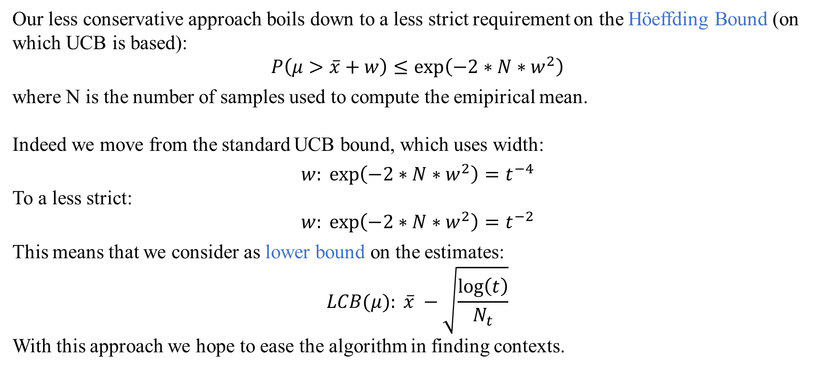
10. Preliminary Considerations
Our less conservative approach boils down to a less strict requirement on the Höeffding Bound (on which UCB is based):
$$P\left(μ>\overline{x}+w\right)≤\exp\left(−2∗N∗w^{2}\right)$$
where N is the number of samples used to compute the emipirical mean.
Indeed we move from the standard UCB bound, which uses width:
$$w: \exp\left(−2∗N∗w^{2}\right)=t^{−4}$$
To a less strict:
$$w: \exp\left(−2∗N∗w^{2}\right)=t^{−2}$$
This means that we consider as lower bound on the estimates:
$$LCB(μ): \overline{x} −\sqrt{\frac{\log\left(t\right)}{N_{t}}}$$
With this approach we hope to ease the algorithm in finding contexts.

Slide 78
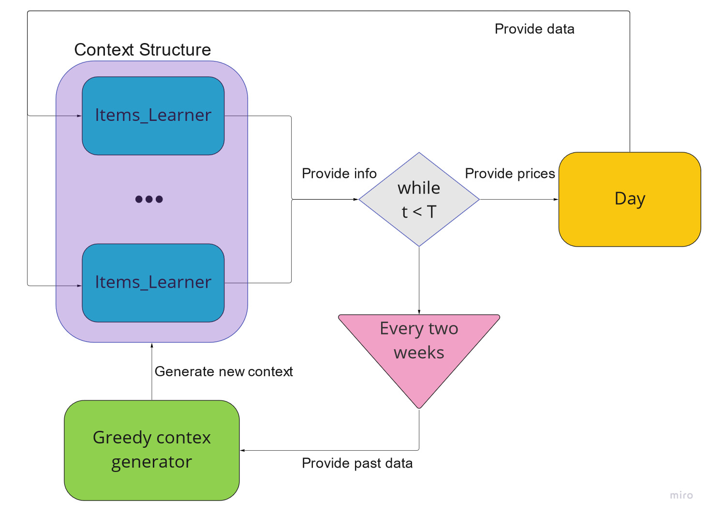
10. Algorithm Structure

Slide 79
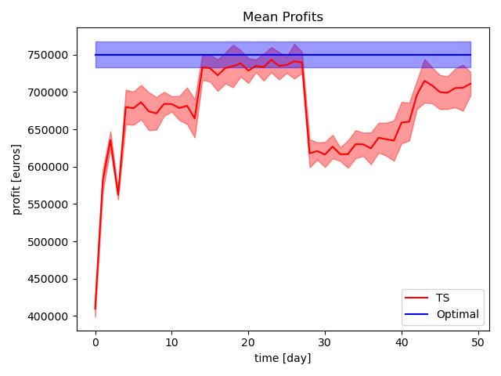
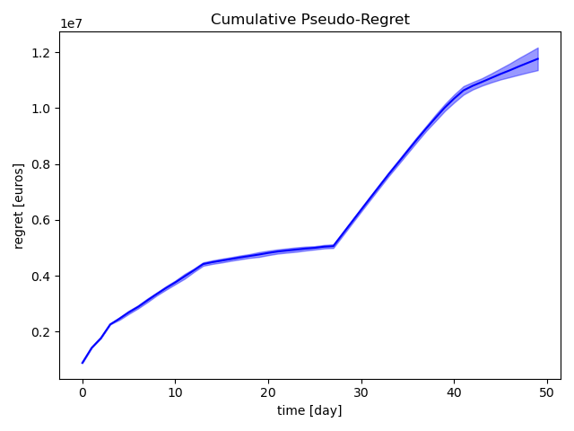
10. Results
As expected, performances are strictly tied to the context structure that has been found, and may differ widely from simulation to simulation.
Profit trends.
Regret trends.

Slide 80
10. Conclusions
As was said in the preliminary considerations, it is clear to see how during the second evaluation of the context, when no split is generated, we are using clearly suboptimal strategies.
To completely solve this problem, one would need an exact context evaluation, as the proposed greedy approach reaches the true context by first evaluating suboptimal ones, were separation could be not worth it and stop the search altogheter. Such a complete algorithm would however be really computationally expensive, if not even unfeasible in a real world example.
Nevertheless, even with a suboptimal splitting procedure this strategy outperforms an aggregated approach.

